Slide 1
Generating Insights to solve Supply Chain Issues

Slide 2
AIM
The Aim of the challenge is to give data analysts/enthusiasts an opportunity to test themselves on real-world business cases and to be able to work right from extracting data, cleaning the messy data, and loading it into a tool where further calculations and visualizations are carried on.
Problem Statement
Vnc Mart is a growing FMCG manufacturer headquartered in Gujarat, India. It is currently operational in three cities Surat, Ahmedabad, and Vadodra. They want to expand to another metro/tier 1 cities in the next 2 years.
Vnc Mart is currently facing a problem where a few key customers did not extend the annual contract due to service issues. It is speculated that some of the essential products were either not delivered on time or not delivered in full over a continued period, which could have resulted in bad customer service. Management wants to fix this issue before expanding to other cities and requested their supply chain analytics team to track the ’On time’ and ‘In Full’ delivery service level for all the customers on a daily basis so that they can respond swiftly to these issues.
The Supply Chain team decided to use a standard approach to measure the service level in which they will measure ‘on-time delivery (OT) %’, ‘In-full delivery (IF) %’, and OnTime in full (OTIF) % of the customer orders on a daily basis against the target service level set for each customer.

Slide 3
Task
Assuming, I am the data analyst in the supply chain team who joined Vnc Mart recently. I have been briefed about the task in the stakeholder business review meeting. Now I am excited to take on this challenge and build this dashboard and perform the following task
Create the metrics according to the metrics list. Create a dashboard according to the requirements provided by stakeholders in the business review meeting. I have been provided with the transcript of this business review meeting in the form of a comic. Create relevant insights that are not provided in the metric list/stakeholder meeting.
KPI
OT % - On-Time Delivery Percentage
IF % - In Full Delivery Percentage
OTIF % - On Time & In Full Delivery Percentage
LIFR – Line Fill Rate
VOFR – Volume Fill Rate (Quantity)
COCT – Customer Order Cycle Time

Slide 4
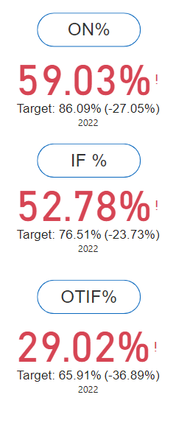
Key Findings
The On-Time Delivery % & In-Full Delivery % are about 30% behind the target % and the trend in all the months is approximately the same and the On Time & In Full Delivery percentage is about 35% less than the target.
Lotus Mart has placed the highest number of orders while OTIF % is only 16.34% and Ontime delivery % is 28,11% which needs to be looked upon, and the orders sent to them are 53.35% Full. The average order cycle time for Lotus Mart is 1.28 days which is the most compared to the other customers. We have a chance of losing this customer, Hence we need to work with a strategy to retain this customer.
Propel Mart has the least Order Cycle Time which is 0.15 days, i.e, it’s almost delivered the same day. This results in happy customer service.

Slide 5
Thank You

